Slide 1
LASP Research Summary

Slide 2
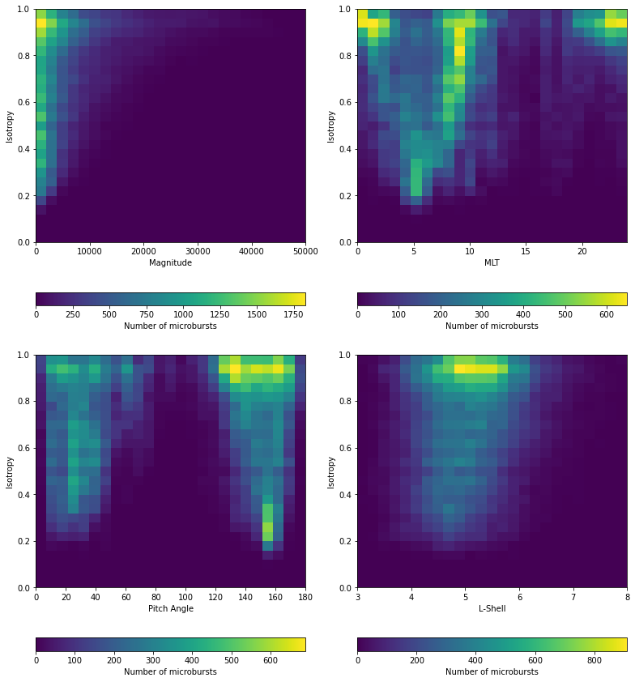
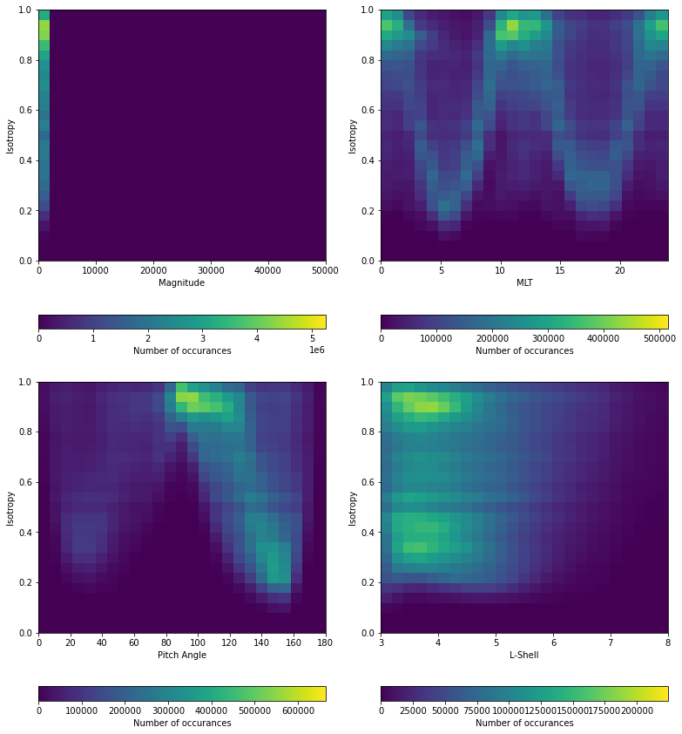
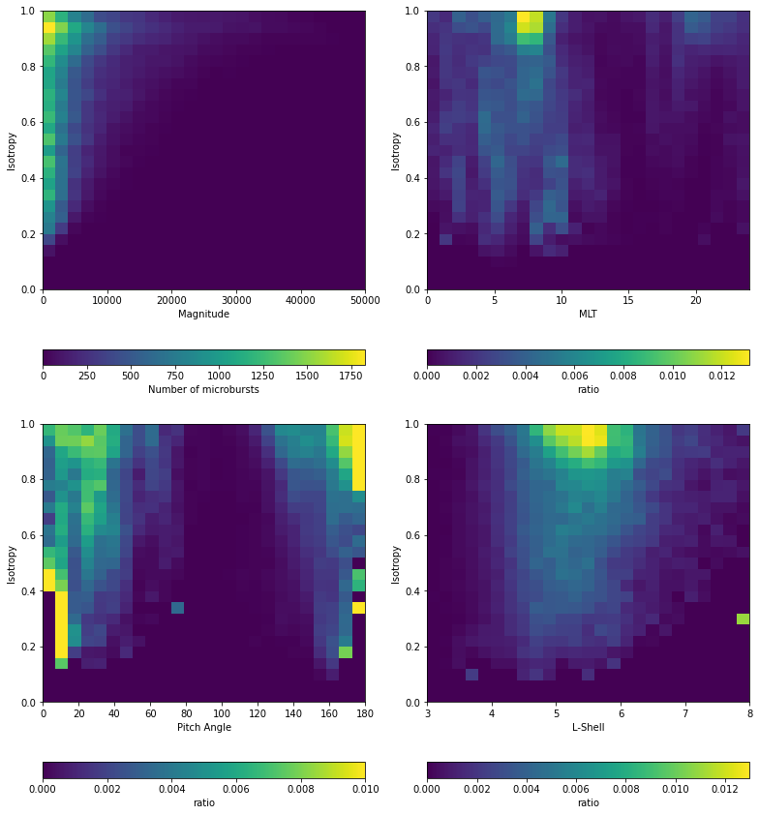
Microburst & Background Iso Correlations
1) Microburst 2) Background 3) Ratio

Slide 3
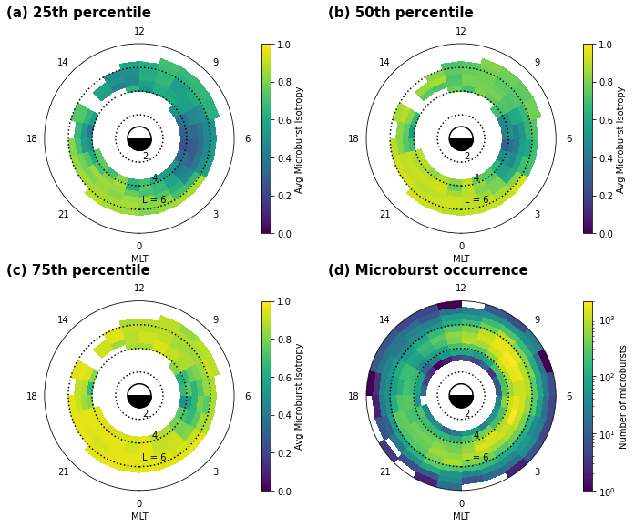
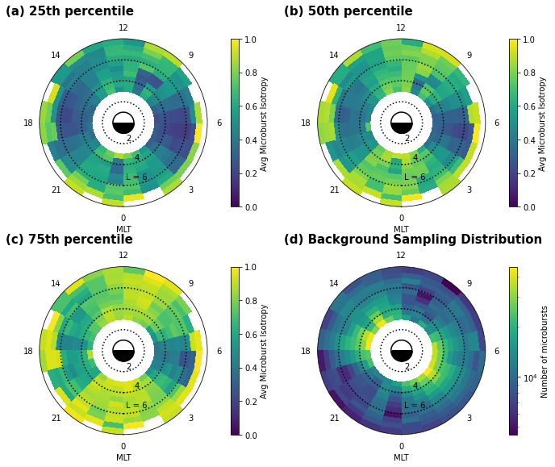
Microburst & Background Iso-MLT-L Plots
1) Microburst 2) Background

Slide 4
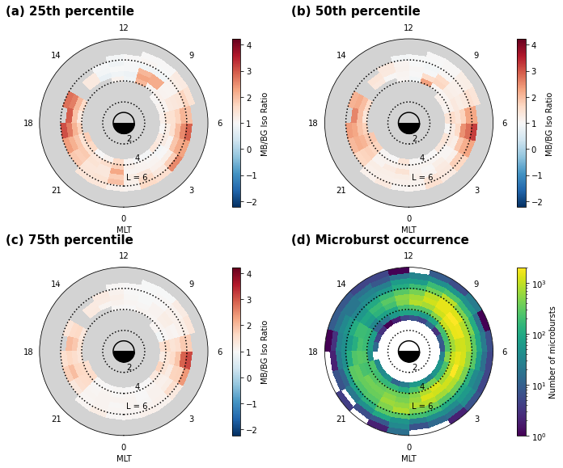
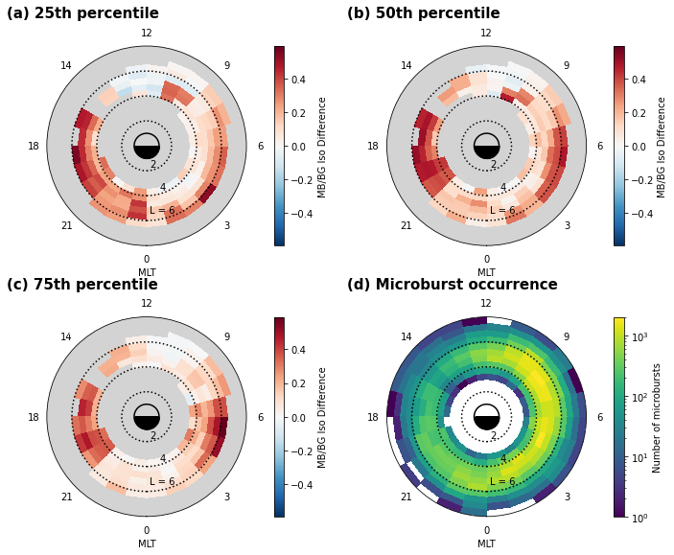
Microburst & Background Iso-MLT-L Plots (cont’d)
1) Ratio 2) Difference

Slide 5
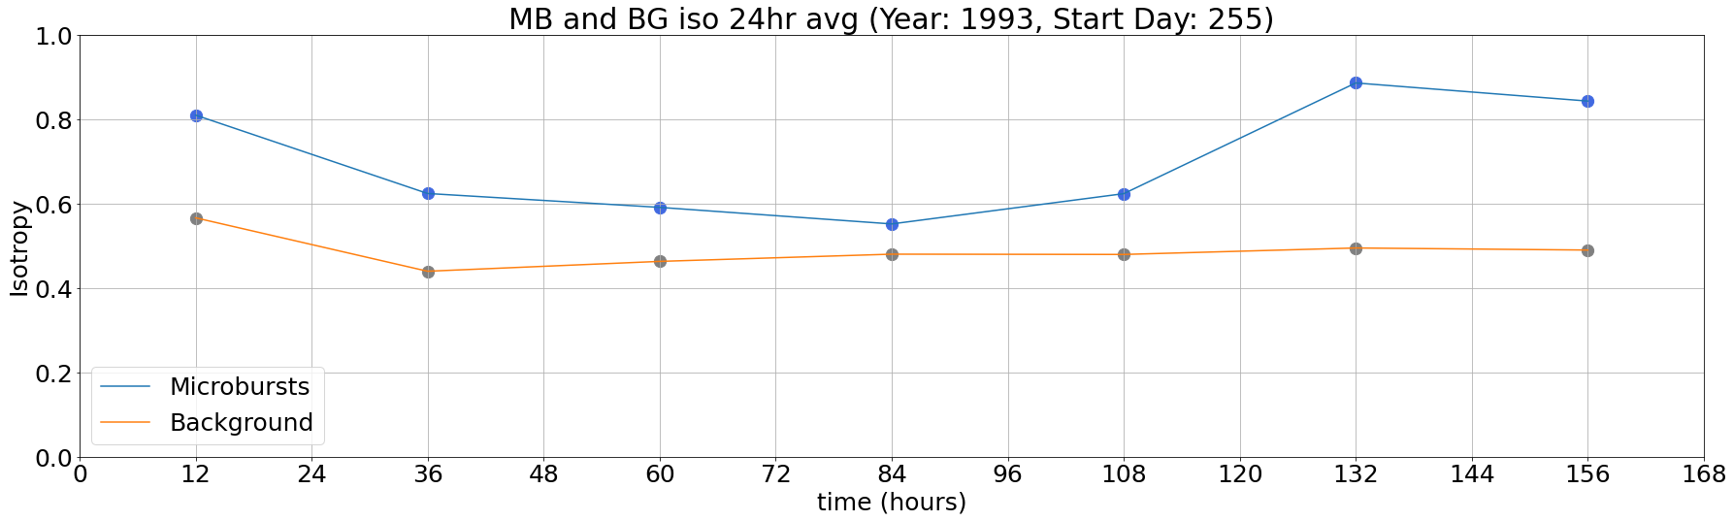
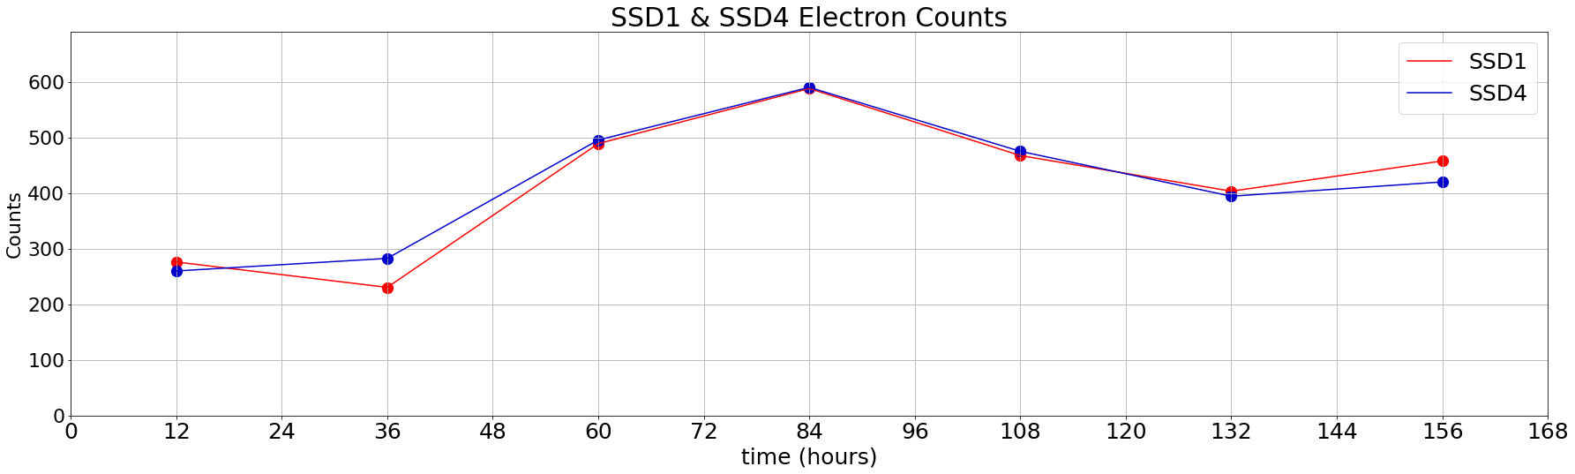
Microburst & Background Isotropy vs Time

Slide 6
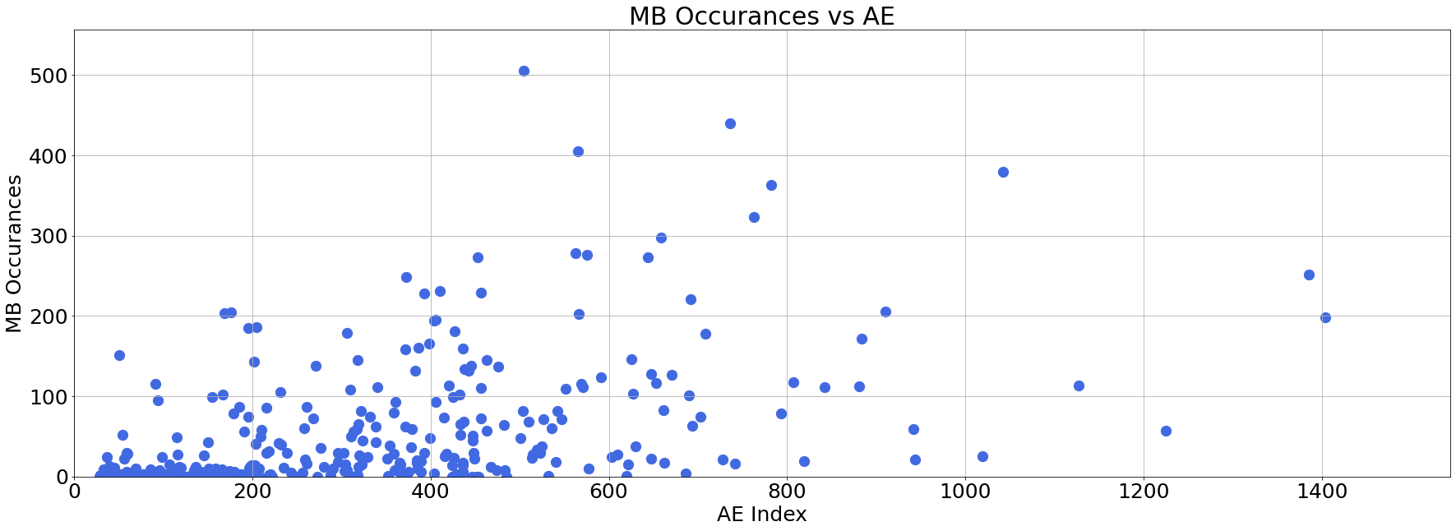
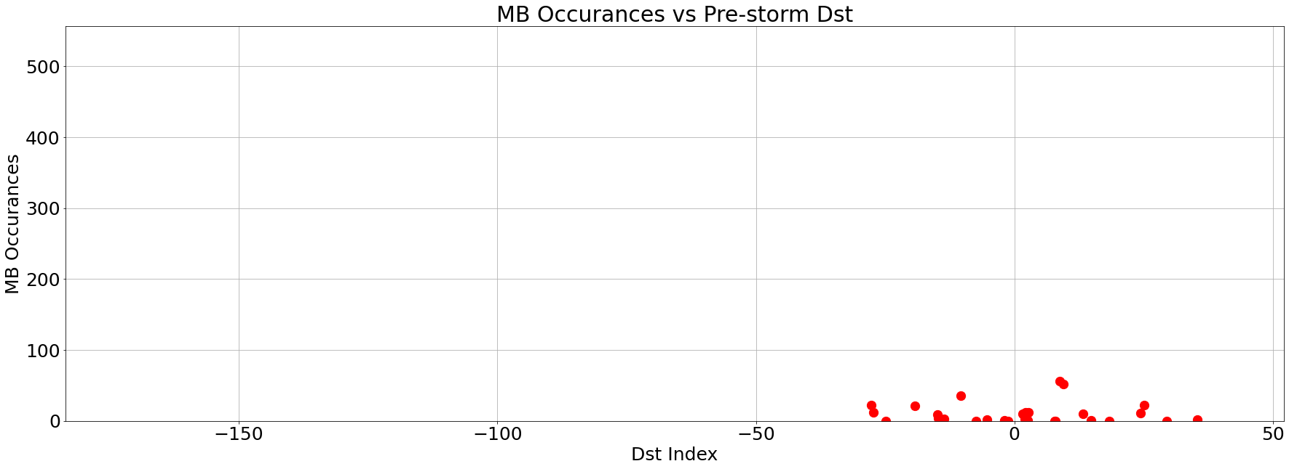
Microburst Occurrences vs Magnetic Indices

Slide 7
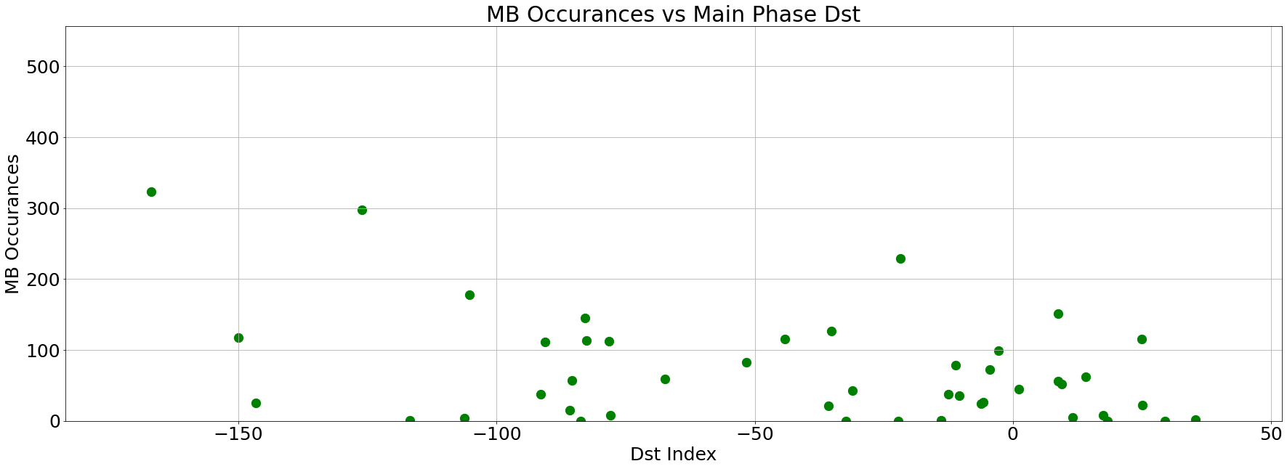
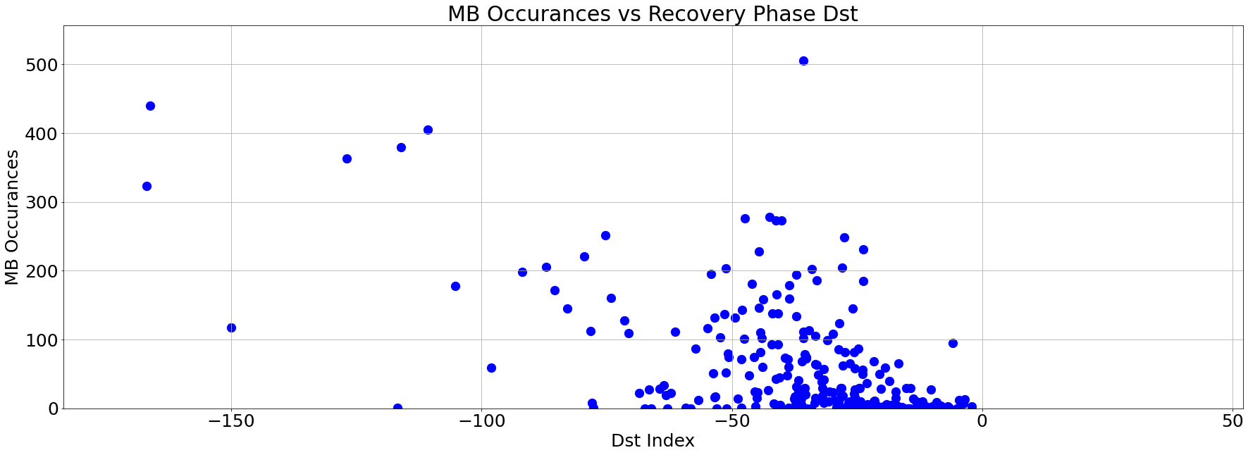
Microburst Occurrences vs Magnetic Indices (cont’d)

